Slide 1

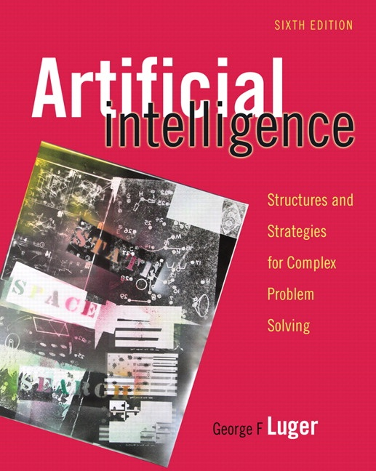
Artificial Intelligence as Empirical Enquiry
16.0 Introduction
16.1 Artificial Intelligence: A Revised Definition
16.2 The Science of Intelligent Systems
16.3 Epilogue and References
16.4 Exercises
George F Luger
ARTIFICIAL INTELLIGENCE 6th edition
Structures and Strategies for Complex Problem Solving
Luger: Artificial Intelligence, 6th edition. © Pearson Education Limited, 2009
1

Slide 2
Based on our experience of the last 16 chapters, we offer a revised definition of Artificial Intelligence:
AI is the study of mechanisms underlying behaviour through the construction and evaluation of artefacts that attempt to enact those mechanisms
Luger: Artificial Intelligence, 6th edition. © Pearson Education Limited, 2009
2

Slide 3
The necessary and sufficient condition for a physical system to exhibit general intelligent action is that it be a physical symbol system.
Sufficient means that intelligence can be achieved by any appropriately organized physical symbol system.
Necessary means that any agent that exhibits general intelligence must be an instance of a physical symbol system. The necessity of the physical symbol system hypothesis requires that any intelligent agent, whether human, space alien, or computer, achieve intelligence through the physical implementation of operations on symbol structures.
General intelligent action means the same scope of action seen in human action. Within physical limits, the system exhibits behavior appropriate to its ends and adaptive to the demands of its environment.
Luger: Artificial Intelligence, 6th edition. © Pearson Education Limited, 2009
3

Slide 4
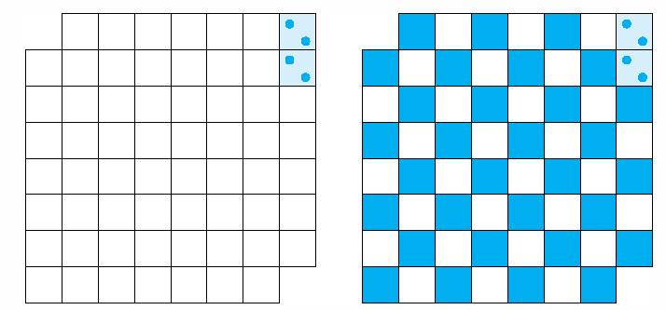
Fig 16.1 Truncated chessboard with two squares covered by a domino.
Luger: Artificial Intelligence, 6th edition. © Pearson Education Limited, 2009
4

Slide 5
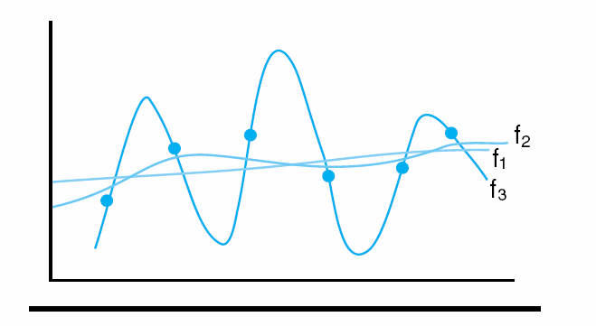
Fig 16.2 A set of data points and three function approximations.
Luger: Artificial Intelligence, 6th edition. © Pearson Education Limited, 2009
5

Slide 6
Critical questions that remain for creating artificial intelligence:
1. The representation problem.
2. The role of embodiment in cognition.
3. Culture and intelligence.
4. Characterizing the nature of interpretation.
5. Representational indeterminacy.
6. The necessity of designing computational models that are falsifiable.
7. The limitations of the scientific method.
Luger: Artificial Intelligence, 6th edition. © Pearson Education Limited, 2009
6

